Slide 1
Chapter 8: Relational Database Design

Slide 2
Chapter 8: Relational Database Design
Features of Good Relational Design
Atomic Domains and First Normal Form
Decomposition Using Functional Dependencies
Functional Dependency Theory
Algorithms for Functional Dependencies
Decomposition Using Multivalued Dependencies
More Normal Form
Database-Design Process
Modeling Temporal Data

Slide 3
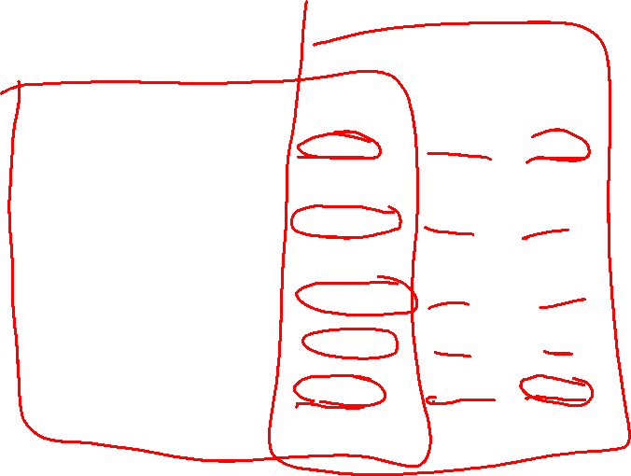
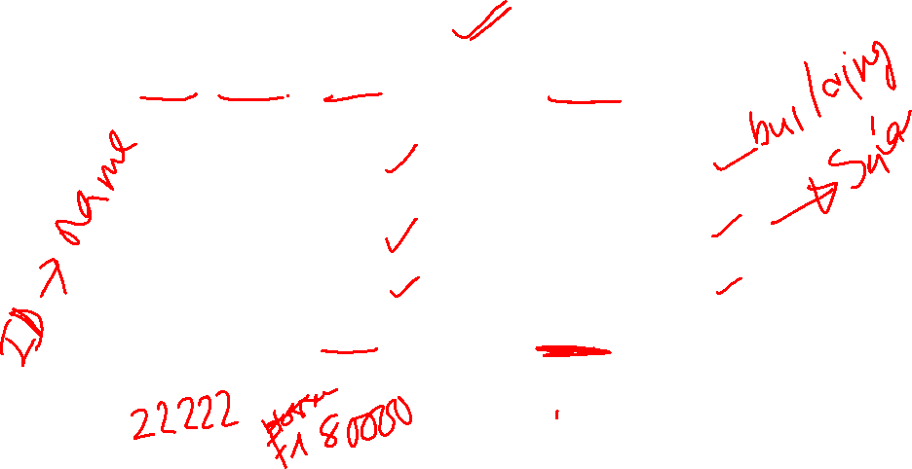

Combine Schemas?
Suppose we combine instructor and department into inst_dept
  (No connection to relationship set inst_dept)
Result is possible repetition of information ( Bad table)

Slide 4

Not all large tables are BAD
Consider combining relations
  sec_class(sec_id, building, room_number) and
  section(course_id, sec_id, semester, year)
  into one relation
  section(course_id, sec_id, semester, year,
  building, room_number)
No repetition in this case (Even for same primary key attributes, other attributes can be different over time)
You can store 100 features about an individual

Slide 5


Bad Tables need to be Decomposed
Suppose we had started with inst_dept. How would we know to split up (decompose) it into instructor and department?
Write a rule “if there were a schema (dept_name, building, budget), then dept_name would be a candidate key”
Denote as a functional dependency:
dept_name → building, budget
In inst_dept, because dept_name is not a candidate key, the building and budget of a department may have to be repeated.
  This indicates the need to decompose inst_dept
  Decomposition is much harder for schemas with large number of attributes
  Need formal methodology, we will see in this chapter.

Slide 6

What About Smaller Schemas?
Not all decompositions are good. Suppose we decompose
employee(ID, name, street, city, salary) into
employee1 (ID, name)
employee2 (name, street, city, salary)
we cannot reconstruct the original employee relation -- and so, this is a lossy decomposition.

Slide 7


A Lossy Decomposition

Slide 8

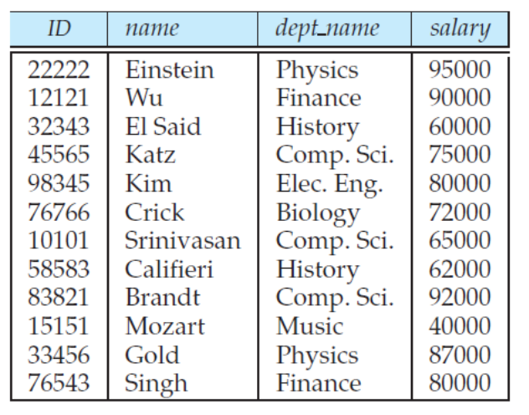
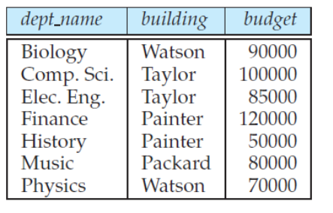
Example of Lossless-Join Decomposition
Inst_dept
the common attribute (being used to decompose) must be primary key for one of the decomposed tables.
Instructor
One record for each department is enough
Department
Natrual Joining of instructor and Deparment will return back original inst-dept table

Slide 9
Are your tables good?
You have some tables from ER diagram. Are they all good?
Test each table to see if they fall under well known forms of good tables.
Ex. First Normal Form( 1NF), Second Normal Form(2NF), Third Normal Form(3NF), Fourth Normal Form (4NF), Boyce CoddNormal Form (BCNF) etc.
We will see all of these form in details first, then test some tables against these forms.

Slide 10
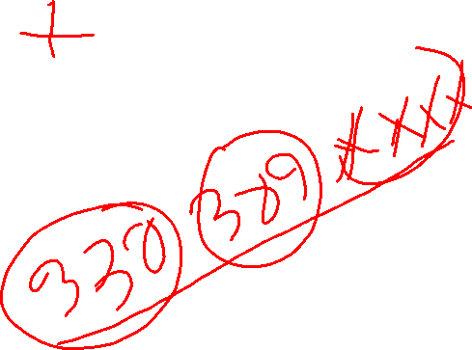
First Normal Form
Domain is atomic if its elements are considered to be indivisible units
  Examples of non-atomic domains:
    Set of names, composite attributes
    Identification numbers like CS101 that can be broken up into parts
A relational schema R is in first normal form if the domains of all attributes of R are atomic.

Slide 11

First Normal Form (Cont’d)
Atomicity is actually a property of how the elements of the domain are used.
  Example: Strings would normally be considered indivisible
  Suppose that students are given roll numbers which are strings of the form CS0012 or EE1127
  If the first two characters are extracted to find the department, the domain of roll numbers is not atomic.
  Doing so is a bad idea: leads to encoding of information in application program rather than in the database.
  Non-atomic attributes are useful, allowed in modern database systems ( in Chapter 22).
  We will consider only first normal form in this chapter ( each attribute atomic)

Slide 12
Other Normal Forms are Based on Functional Dependency

Slide 13
Functional Dependencies
Real world Constraints on the set of legal relations.
  Ex. Students and instructors are uniquely identified by their ID
  Legal instance of a relation satisfies all real world constraints
Require that the value for a certain set of attributes determines uniquely the value for another set of attributes.
A functional dependency is a generalization of the notion of a key.

Slide 14

Notations revised
we use Greek letters for sets of attributes (for example β)
r (R) – schema R for relation r,
When a set of attributes is a superkey,we denote it by K.
We use a lowercase name for relations.

Slide 15
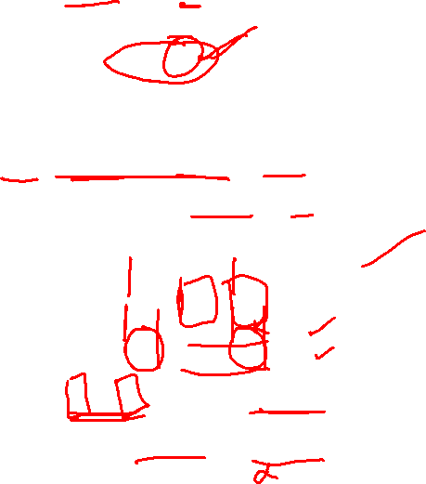
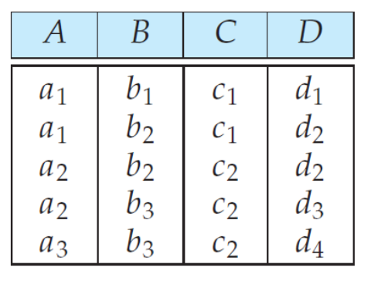
Functional Dependencies (Cont.)
Let R be a relation schema
α ⊆ R and β ⊆ R
The functional dependency
α → β
holds on R if and only if for any legal relations r(R), whenever any two tuples t₁ and t₂ of r agree on the attributes α, they also agree on the attributes β. That is,
t₁[α] = t₂ [α] ⇒ t₁[β ] = t₂ [β ]
Example: Consider r(A,B, C, D ) with the following instance of r.
On this instance, A → C holds, but C → A doesn’t.
How about B → C, and BC → D ?

Slide 16
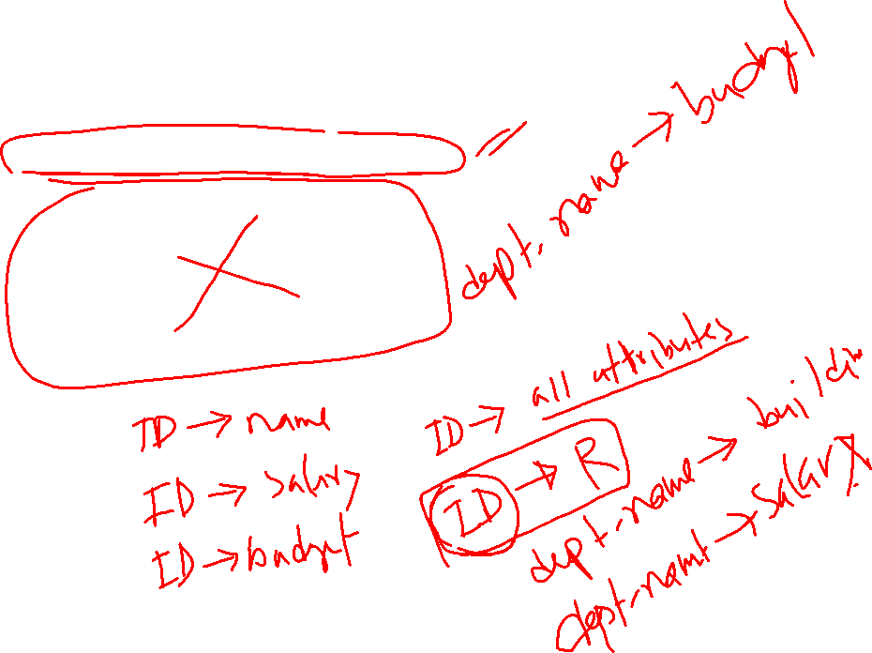
Functional Dependencies (Cont.)
What are the functional dependencies for following table?
Instance of a table might not show actual functional dependencies, you have to also consider real world practice.

Slide 17
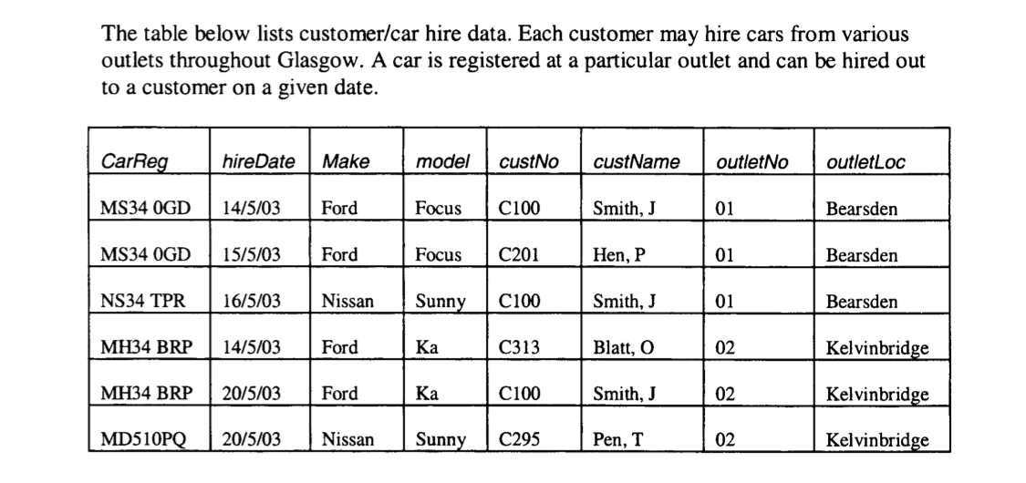
Functional Dependency: Practice
We want to store customer/car rental data in the following schema ( Say for Enterprise car rental).
Write functional all functional dependencies for the schema:
FDs:

Slide 18
Functional Dependency: Practice
Sample data doesn’t represent the real scenario- Write functional dependency considering data, then compare with FDs in previous slide

Slide 19
Functional Dependencies (Cont.)
A functional dependency is trivial if it is satisfied by all instances of a relation
  Example:
    ID, name → ID [ if you know ID, name, you can identify ID uniquely ]
    name → name
  In general, α → β is trivial if β ⊆ α

Slide 20
Super key and functional dependency
superkey - uniquely identifies an entire tuple,
  ID uniquely identifies all attributes of the table
functional dependency - helps to uniquely identify the values of certain attributes.
  dept_name uniqley identifies building and budget
So we can define super key in terms of functional dependency

Slide 21
Functional Dependencies (Cont.)
K is a superkey for relation schema R if and only if K → R
K is a candidate key for R if and only if
  K → R, and
  for no α ⊂ K, α → R
Functional dependencies allow us to express constraints that cannot be expressed using superkeys. Consider the schema:
inst_dept (ID, name, salary, dept_name, building, budget ).
We expect these functional dependencies to hold:
dept_name→ building
and ID → building
but would not expect the following to hold:
dept_name → salary
This is how you define functional dependency on tables

Slide 22
Use of Functional Dependencies
We use functional dependencies to:
  test relations to see if they are legal under a given set of functional dependencies.
    If a relation r is legal under a set F of functional dependencies, we say that r satisfies F.
  specify constraints on the set of legal relations
    We say that F holds on R if all legal relations on R satisfy the set of functional dependencies F.
Note: A specific instance of a relation schema may satisfy a functional dependency even if the functional dependency does not hold on all legal instances.
  For example, a specific instance of instructor may, by chance, satisfy
  name → ID.

Slide 23
Use of Functional Dependencies
We want dept_name -> budget. Check as follows.
  SELECT dept_name,COUNT(DISTINCT budget) FROM inst_dept GROUP BY dept_name

Slide 24
Closure of a Set of Functional Dependencies
Given a set F set of functional dependencies, there are certain other functional dependencies that are logically implied by F.
  For e.g.: If A → B and B → C, then we can infer that A → C
The set of all functional dependencies logically implied by F is the closure of F.
We denote the closure of F by F⁺.

Slide 25
Boyce-Codd Normal Form Based on FD
A relation schema R is in BCNF with respect to a set F of functional dependencies if for all functional dependencies in F⁺ of the form
α → β
where α ⊆ R and β ⊆ R, at least one of the following holds:
α → β is trivial (i.e., β ⊆ α)
α is a superkey for R
Example schema not in BCNF: why?
instr_dept (ID, name, salary, dept_name, building, budget )
because dept_name→ building, budget
holds on instr_dept, but dept_name is not a superkey

Slide 26
Decomposing a Schema into BCNF
Suppose we have a schema R and a non-trivial dependency α→β causes a violation of BCNF.
We decompose R into:
  (α U β )
  ( R - ( β - α ) )
In our example, α→β is dept_name→ building, budget
  α = dept_name
  β = building, budget
  R = ( ID, name, salary, dept_name, building, budget )
  and inst_dept is replaced by
  (α U β ) = ( dept_name, building, budget )
  ( R - ( β - α ) ) = ( ID, name, salary, dept_name )
  α common in both tables
Some of the relations after decomposition might not be BCNF. Needs further decomposition

Slide 27
BCNF and Dependency Preservation
instr_dept (ID, name, salary, dept_name, building, budget )
We had
  ID-> name, salary, dept_name, building, budget
  dept_name -> building, budget
After decomposition, we have,
  Instructor(ID, name, dept_name, salary)
    ID->name, dept_name, salary
  Department(dept_name, building, budget)
    dept_name -> building, budget
Can we check if we still have,
  ID-> name, salary, dept_name, building, budget ?
  Yes, we have algorithms

Slide 28
BCNF and Dependency Preservation
Constraints, including functional dependencies, are costly to check in practice unless they pertain to only one relation
If it is sufficient to test only those dependencies on each individual relation of a decomposition in order to ensure that all functional dependencies hold, then that decomposition is dependency preserving.
Because it is not always possible to achieve both BCNF and dependency preservation, we consider a weaker normal form, known as third normal form.

Slide 29
Third Normal Form
A relation schema R is in third normal form (3NF) if for all:
α → β in F⁺
at least one of the following holds:
  α → β is trivial (i.e., β ∈ α)
  α is a superkey for R
  Each attribute A in β – α is contained in a candidate key for R.
  (NOTE: each attribute may be in a different candidate key)
If a relation is in BCNF it is in 3NF (since in BCNF one of the first two conditions above must hold).
Third condition is a minimal relaxation of BCNF to ensure dependency preservation (will see why later).
This allows some dependencies α → β, where α is not super key

Slide 30
3NF Example
Relation dept_advisor:
  dept_advisor (s_ID, i_ID, dept_name)
  F = {s_ID, dept_name → i_ID, i_ID → dept_name}
  Two candidate keys: s_ID, dept_name, and i_ID, s_ID
R is Not BCNF as i_ID is not super key. So decompose
  (i_ID, dept name)
  (s_ID, i_ID)
  Can’t preserve s_ID, dept_name → i_ID
R is in 3NF
  s_ID, dept_name → i_ID
    s_ID, dept_name is a superkey
  i_ID → dept_name
    dept_name is contained in a candidate key

Slide 31
Goals of Normalization
Let R be a relation scheme with a set F of functional dependencies.
Decide whether a relation scheme R is in “good” form.
In the case that a relation scheme R is not in “good” form ( not BCNF or 3NF), decompose it into a set of relation scheme {R₁, R₂, ..., R_{n}} such that
  each relation scheme is in good form
  the decomposition is a lossless-join decomposition
  Preferably, the decomposition should be dependency preserving.

Slide 32
Comparison of BCNF and 3NF
It is always possible to decompose a relation into a set of relations that are in 3NF such that:
  the decomposition is lossless
  the dependencies are preserved
It is always possible to decompose a relation into a set of relations that are in BCNF such that:
  the decomposition is lossless
  it may not be possible to preserve dependencies.

Slide 33
Design Goals
Goal for a relational database design is:
  BCNF.
  Lossless join.
  Dependency preservation.
If we cannot achieve this, we accept one of
  Lack of dependency preservation
  Redundancy due to use of 3NF
For practice go to: http://www.ict.griffith.edu.au/~jw/normalization/index.html

Slide 34
Functional-Dependency Theory
We now consider the formal theory that tells us which functional dependencies are implied logically by a given set of functional dependencies. ( Calculate F+)
We then develop algorithms to generate lossless decompositions into BCNF and 3NF
We then develop algorithms to test if a decomposition is dependency-preserving

Slide 35
Closure of a Set of Functional Dependencies
We can find F^{+,} the closure of F, by repeatedly applying
Armstrong’s Axioms:
  if β ⊆ α, then α → β (reflexivity)
  if α → β, then γ α → γ β (augmentation)
  if α → β, and β → γ, then α → γ (transitivity)

Slide 36
Example
R = (A, B, C, G, H, I)
F = { A → B
A → C
CG → H
CG → I
B → H}
some members of F⁺
  A → H
    by transitivity from A → B and B → H
  AG → I
    by augmenting A → C with G, to get AG → CG
    and then transitivity with CG → I
  CG → HI
    by augmenting CG → I to infer CG → CGI,
    and augmenting of CG → H to infer CGI → HI,
    and then transitivity

Slide 37
Procedure for Computing F⁺
To compute the closure of a set of functional dependencies F:
F ⁺ = F
repeat
for each functional dependency f in F⁺
apply reflexivity and augmentation rules on f
add the resulting functional dependencies to F ⁺
for each pair of functional dependencies f₁and f₂ in F ⁺
if f₁ and f₂ can be combined using transitivity
then add the resulting functional dependency to F ⁺
until F ⁺ does not change any further
NOTE: We shall see an alternative procedure for this task later

Slide 38
Closure of Functional Dependencies (Cont.)
Additional rules:
  If α → β holds and α → γ holds, then α → β γ holds (union)
  If α → β γ holds, then α → β holds and α → γ holds (decomposition)
  If α → β holds and γ β → δ holds, then α γ → δ holds (pseudotransitivity)
  The above rules can be inferred from Armstrong’s axioms.

Slide 39
Closure of Attribute Sets
Given a set of attributes α, define the closure of α under F (denoted by α⁺) as the set of attributes that are functionally determined by α under F
Helps to determine if α is super key (from α → β ).
Algorithm to compute α⁺, the closure of α under F
result := α;
while (changes to result) do
for each β → γ in F do
begin
if β ⊆ result then result := result ∪ γ
end

Slide 40
Example of Attribute Set Closure
R = (A, B, C, G, H, I)
F = {A → B
A → C
CG → H
CG → I
B → H}
(AG)⁺
  1. result = AG
  2. result = ABCG (A → C and A → B)
  3. result = ABCGH (CG → H and CG ⊆ AGBC)
  4. result = ABCGHI (CG → I and CG ⊆ AGBCH)
Is AG a candidate key?
  Is AG a super key?
    Does AG → R? == Is (AG)⁺ ⊇ R
  Is any subset of AG a superkey?
    Does A → R? == Is (A)⁺ ⊇ R
    Does G → R? == Is (G)⁺ ⊇ R
How about finding candidate key

Slide 41
Uses of Attribute Closure
There are several uses of the attribute closure algorithm:
Testing for superkey:
  To test if α is a superkey, we compute α^{+,} and check if α⁺ contains all attributes of R.
Testing functional dependencies
  To check if a functional dependency α → β holds (or, in other words, is in F⁺), just check if β ⊆ α⁺.
  That is, we compute α⁺ by using attribute closure, and then check if it contains β.
  Is a simple and cheap test, and very useful
Computing closure of F
  For each γ ⊆ R, we find the closure γ⁺, and for each S ⊆ γ⁺, we output a functional dependency γ → S.
(AG)⁺ =( ABCGHI)
AG -> A
AG -> B
AG->CG and so on

Slide 42
Canonical Cover
Each update on database must satisfy all functional dependency, If not roll back
Need to test on minimal set of FDs ( Canonical Cover)
Sets of functional dependencies may have redundant dependencies that can be inferred from the others
  For example: A → C is redundant in: {A → B, B → C, A→ C}
  Parts of a functional dependency may be redundant
    E.g.: on RHS: {A → B, B → C, A → CD} can be simplified to
    {A → B, B → C, A → D}
    E.g.: on LHS: {A → B, B → C, AC → D} can be simplified to
    {A → B, B → C, A → D}
Intuitively, a canonical cover of F is a “minimal” set of functional dependencies equivalent to F, having no redundant dependencies or redundant parts of dependencies

Slide 43
Extraneous Attributes
Consider a set F of functional dependencies and the functional dependency α → β in F.
  Attribute A is extraneous in α if A ∈ α
  and F logically implies (F – {α → β}) ∪ {(α – A) → β}.
  Attribute A is extraneous in β if A ∈ β
  and the set of functional dependencies
  (F – {α → β}) ∪ {α →(β – A)} logically implies F.
Example: Given F = {A → C, AB → C }
  B is extraneous in AB → C because {A → C, AB → C} logically implies A → C (I.e. the result of dropping B from AB → C).
Example: Given F = {A → C, AB → CD}
  C is extraneous in AB → CD since AB → C can be inferred even after deleting C

Slide 44
Testing if an Attribute is Extraneous
Consider a set F of functional dependencies and the functional dependency α → β in F.
To test if attribute A ∈ α is extraneous in α
  compute ({α} – A)⁺ using the dependencies in F
  check that ({α} – A)⁺ contains β; if it does, A is extraneous in α
To test if attribute A ∈ β is extraneous in β
  compute α⁺ using only the dependencies in
  F’ = (F – {α → β}) ∪ {α →(β – A)},
  check that α⁺ contains A; if it does, A is extraneous in β

Slide 45
Canonical Cover
A canonical cover for F is a set of dependencies F_{c} such that
  F logically implies all dependencies in F_{c,} and
  F_{c} logically implies all dependencies in F, and
  No functional dependency in F_{c} contains an extraneous attribute, and
  Each left side of functional dependency in F_{c} is unique.
To compute a canonical cover for F:
repeat
Use the union rule to replace any dependencies in F
α₁ → β₁ and α₁ → β₂ with α₁ → β₁ β₂
Find a functional dependency α → β with an
extraneous attribute either in α or in β
/* Note: test for extraneous attributes done using F_{c,} not F*/
If an extraneous attribute is found, delete it from α → β
until F does not change
Note: Union rule may become applicable after some extraneous attributes have been deleted, so it has to be re-applied

Slide 46
Computing a Canonical Cover
R = (A, B, C)
F = {A → BC
B → C
A → B
AB → C}
Combine A → BC and A → B into A → BC
  Set is now {A → BC, B → C, AB → C}
A is extraneous in AB → C
  Check if the result of deleting A from AB → C is implied by the other dependencies
    Yes: in fact, B → C is already present!
  Set is now {A → BC, B → C}
C is extraneous in A → BC
  Check if A → C is logically implied by A → B and the other dependencies
    Yes: using transitivity on A → B and B → C.
      Can use attribute closure of A in more complex cases
The canonical cover is: A → B
B → C

Slide 47
Functional-Dependency Theory
We now consider the formal theory that tells us which functional dependencies are implied logically by a given set of functional dependencies.
We then develop algorithms to generate lossless decompositions into BCNF and 3NF
We then develop algorithms to test if a decomposition is dependency-preserving

Slide 48
Lossless-join Decomposition
For the case of R = (R₁, R₂), we require that for all possible relations r on schema R
r = ∏_{R1} (r ) ∏_{R2} (r )
select * from ( select R1 from r) natural join ( select R2 from r)
- this should gives r.
A decomposition of R into R₁ and R₂ is lossless join if at least one of the following dependencies is in F⁺:
  R₁ ∩ R₂ → R1 [ similar to K-> R, where k is super key for R]
  R₁ ∩ R₂ → R₂
The above functional dependencies are a sufficient condition for lossless join decomposition.

Slide 49
Example: Lossless Decomposition
  R = ( ID, name, salary, dept_name, building, budget )
  R1( ID, name, salary, dept_name )
  R2 = ( dept_name, building, budget )
  R₁ ∩ R₂ = dept_name, which is super key for R2
  So, R₁ ∩ R₂ → R_{2 Holds}

Slide 50
A Lossy Decomposition
R
R1
R2
  R₁ ∩ R₂ → R_{1 none of these FDs holds}
  R₁ ∩ R₂ → R₂

Slide 51
Dependency Preservation
Let F_{i} be the set of dependencies F ⁺ that include only attributes in R_{i}.
    A decomposition is dependency preserving, if
    (F₁ ∪ F₂ ∪ … ∪ F_{n} )⁺ = F ⁺
    If it is not, then checking updates for violation of functional dependencies may require computing joins, which is expensive.

Slide 52

Example: Lossless Decomp. with Dependency Preservation
R = (A, B, C)
F = {A → B, B → C)
R is not BCNF, Why?
  Can be decomposed in two different ways
R₁ = (A, B), R₂ = (B, C)
  Lossless-join decomposition:
  R₁ ∩ R₂ = {B} and B → BC
  Dependency preserving
R₁ = (A, B), R₂ = (A, C)
  Lossless-join decomposition:
  R₁ ∩ R₂ = {A} and A → AB
  Not dependency preserving
  (cannot check B → C without computing R₁ R₂)
So, first decomposition is desirable

Slide 53
Testing for Dependency Preservation
To check if a dependency α → β is preserved in a decomposition of R into R₁, R₂, …, R_{n} we apply the following test (with attribute closure done with respect to F)
  result = α
  while (changes to result) do
  for each R_{i} in the decomposition
  t = (result ∩ R_{i})⁺ ∩ R_{i}
  result = result ∪ t
  If result contains all attributes in β, then the functional dependency
  α → β is preserved.
We apply the test on all dependencies in F to check if a decomposition is dependency preserving
This procedure takes polynomial time, instead of the exponential time required to compute F⁺ and (F₁ ∪ F₂ ∪ … ∪ F_{n})⁺

Slide 54
Example
R = (A, B, C )
F = {A → B
B → C}
Key = {A}
Decomposition R₁ = (A, B), R₂ = (A, C)
  R₁ and R₂ in BCNF
  Lossless-join decomposition
  Dependency preserving ?, check if B -> C preserve
    Result = B
      For R1
      t = (B ∩ R1)+ ∩ R1 = BC ∩ AB = B
      result = B
      For R2
      t = (B ∩ R2)+ ∩ R2 = Ø ∩ R2 = Ø
      result = B, As C is not in result B-> C doesn’t hold

Slide 55
Goals of Normalization (review)
Let R be a relation scheme with a set F of functional dependencies.
Decide whether a relation scheme R is in “good” form.
In the case that a relation scheme R is not in “good” form, decompose it into a set of relation scheme {R₁, R₂, ..., R_{n}} such that
  each relation scheme is in good form
  the decomposition is a lossless-join decomposition
  Preferably, the decomposition should be dependency preserving.

Slide 56
Testing for BCNF
To check if a non-trivial dependency α →β causes a violation of BCNF
  1. compute α⁺ (the attribute closure of α), and
  2. verify that it includes all attributes of R, that is, it is a superkey of R.
Simplified test: To check if a relation schema R is in BCNF, it suffices to check only the dependencies in the given set F for violation of BCNF, rather than checking all dependencies in F⁺.
  If none of the dependencies in F causes a violation of BCNF, then none of the dependencies in F⁺ will cause a violation of BCNF either.
However, simplified test using only F is incorrect when testing a relation in a decomposition of R
  Consider R = (A, B, C, D, E), with F = { A → B, BC → D}
    Decompose R into R₁ = (A,B) and R₂ = (A,C,D, E)
    Neither of the dependencies in F contain only attributes from
    (A,C,D,E) so we might be mislead into thinking R₂ satisfies BCNF.
    In fact, dependency AC → D in F⁺ shows R₂ is not in BCNF.

Slide 57
Testing Decomposition for BCNF
To check if a relation R_{i} in a decomposition of R is in BCNF,
  Either test R_{i} for BCNF with respect to the restriction of F to R_{i} (that is, all FDs in F⁺ that contain only attributes from R_{i})
  or use the original set of dependencies F that hold on R, but with the following test:
      for every set of attributes α ⊆ R_{i}, check that α⁺ (the attribute closure of α) either includes no attribute of R_{i}- α, or includes all attributes of R_{i}.

Slide 58
BCNF Decomposition Algorithm
result := {R }; // set of tables not attributes
done := false;
compute F ⁺;
while (not done) do
if (there is a schema R_{i} in result that is not in BCNF)
then begin
let α → β be a nontrivial functional dependency that
holds on R_{i} such that α → R_{i} is not in F ⁺, and α ∩ β = ∅;
result := (result – R_{i} ) ∪ (R_{i} – β) ∪ (α, β ); // remove one non-BCNF add two BCNF to the result
end
else done := true;
Note: each R_{i} is in BCNF, and decomposition is lossless-join.

Slide 59
Example of BCNF Decomposition
class (course_id, title, dept_name, credits, sec_id, semester, year, building, room_number, capacity, time_slot_id)
Functional dependencies:
  course_id→ title, dept_name, credits
  building, room_number→capacity
  course_id, sec_id, semester, year→building, room_number, time_slot_id
A candidate key {course_id, sec_id, semester, year}.
BCNF Decomposition:
  course_id→ title, dept_name, credits holds
    but course_id is not a superkey.
  We replace class by:
    course(course_id, title, dept_name, credits)
    class-1 (course_id, sec_id, semester, year, building,
    room_number, capacity, time_slot_id)

Slide 60
BCNF Decomposition (Cont.)
course is in BCNF
  How do we know this?
building, room_number→capacity holds on class-1
  but {building, room_number} is not a superkey for class-1.
  We replace class-1 by:
    classroom (building, room_number, capacity)
    section (course_id, sec_id, semester, year, building, room_number, time_slot_id)
classroom and section are in BCNF.

Slide 61
BCNF and Dependency Preservation
It is not always possible to get a BCNF decomposition that is
dependency preserving
R = (J, K, L )
F = {JK → L
L → K }
Two candidate keys = JK and JL
R is not in BCNF
Any decomposition of R will fail to preserve
JK → L
This implies that testing for JK → L requires a join

Slide 62
Third Normal Form: Motivation
There are some situations where
  BCNF is not dependency preserving, and
  efficient checking for FD violation on updates is important
Solution: define a weaker normal form, called Third Normal Form (3NF)
  Allows some redundancy (with resultant problems; we will see examples later)
  But functional dependencies can be checked on individual relations without computing a join.
  There is always a lossless-join, dependency-preserving decomposition into 3NF.

Slide 63
Third Normal Form
A relation schema R is in third normal form (3NF) if for all:
α → β in F⁺
at least one of the following holds:
  α → β is trivial (i.e., β ∈ α)
  α is a superkey for R
  Each attribute A in β – α is contained in a candidate key for R.
  (NOTE: each attribute may be in a different candidate key)
If a relation is in BCNF it is in 3NF (since in BCNF one of the first two conditions above must hold).
Third condition is a minimal relaxation of BCNF to ensure dependency preservation.
This allows some dependencies α → β, where α is not super key

Slide 64
Redundancy in 3NF
There is some redundancy in this schema
Example of problems due to redundancy in 3NF
  R = (J, K, L)
  F = {JK → L, L → K }
J
L
K
j₁
j₂
j₃
null
l₁
l₁
l₁
l₂
k₁
k₁
k₁
k₂
repetition of information (e.g., the relationship l₁, k₁)
  (i_ID, dept_name)
need to use null values (e.g., to represent the relationship
l₂, k₂ where there is no corresponding value for J).
  (i_ID, dept_name) if there is no separate relation mapping instructors to departments

Slide 65
Testing for 3NF
Optimization: Need to check only FDs in F, need not check all FDs in F⁺.
Use attribute closure to check for each dependency α → β, if α is a superkey.
If α is not a superkey, we have to verify if each attribute in β is contained in a candidate key of R
  this test is rather more expensive, since it involve finding candidate keys
  testing for 3NF has been shown to be NP-hard
  Interestingly, decomposition into third normal form (described shortly) can be done in polynomial time

Slide 66
3NF Decomposition Algorithm
Let F_{c} be a canonical cover for F;
i := 0;
for each functional dependency α → β in F_{c} do
if none of the schemas R_{j}, 1 ≤ j ≤ i contains α β
then begin
i := i + 1;
R_{i} := α β
end
if none of the schemas R_{j}, 1 ≤ j ≤ i contains a candidate key for R
then begin
i := i + 1;
R_{i} := any candidate key for R;
end
/* Optionally, remove redundant relations */
repeat
if any schema R_{j} is contained in another schema R_{k}
then /* delete R_{j} */
R_{j} = Ri ; // replace with last table in current list of tables
i=i-1;
return (R₁, R₂, ..., R_{i})

Slide 67
3NF Decomposition Algorithm (Cont.)
Above algorithm ensures:
  each relation schema R_{i} is in 3NF
  decomposition is dependency preserving and lossless-join
  Proof of correctness is at end of this presentation (click here)

Slide 68
3NF Decomposition: An Example
Relation schema:
  cust_banker_branch = (customer_id, employee_id, branch_name, type )
The functional dependencies for this relation schema are:
  customer_id, employee_id → branch_name, type
  employee_id → branch_name
  customer_id, branch_name → employee_id
We first compute a canonical cover
  branch_name is extraneous in the r.h.s. of the 1st dependency
  No other attribute is extraneous, so we get F_{C} =
  customer_id, employee_id → type
  employee_id → branch_name
  customer_id, branch_name → employee_id

Slide 69
3NF Decompsition Example (Cont.)
The for loop generates following 3NF schema:
(customer_id, employee_id, type )
(employee_id, branch_name)
(customer_id, branch_name, employee_id)
  Observe that (customer_id, employee_id, type ) contains a candidate key of the original schema, so no further relation schema needs be added
At end of for loop, detect and delete schemas, such as (employee_id, branch_name), which are subsets of other schemas
  result will not depend on the order in which FDs are considered
The resultant simplified 3NF schema is:
(customer_id, employee_id, type)
(customer_id, branch_name, employee_id)

Slide 70
Comparison of BCNF and 3NF
It is always possible to decompose a relation into a set of relations that are in 3NF such that:
  the decomposition is lossless
  the dependencies are preserved
It is always possible to decompose a relation into a set of relations that are in BCNF such that:
  the decomposition is lossless
  it may not be possible to preserve dependencies.

Slide 71
Design Goals
Goal for a relational database design is:
  BCNF.
  Lossless join.
  Dependency preservation.
If we cannot achieve this, we accept one of
  Lack of dependency preservation
  Redundancy due to use of 3NF

Slide 72
End of Chapter

Slide 73
Proof of Correctness of 3NF Decomposition Algorithm

Slide 74
Correctness of 3NF Decomposition Algorithm
3NF decomposition algorithm is dependency preserving (since there is a relation for every FD in F_{c})
Decomposition is lossless
  A candidate key (C ) is in one of the relations R_{i} in decomposition
  Closure of candidate key under F_{c} must contain all attributes in R.
  Follow the steps of attribute closure algorithm to show there is only one tuple in the join result for each tuple in R_{i}

Slide 75
Correctness of 3NF Decomposition Algorithm (Cont’d.)
Claim: if a relation R_{i} is in the decomposition generated by the
above algorithm, then R_{i} satisfies 3NF.
Let R_{i} be generated from the dependency α → β
Let γ → B be any non-trivial functional dependency on R_{i}. (We need only consider FDs whose right-hand side is a single attribute.)
Now, B can be in either β or α but not in both. Consider each case separately.

Slide 76
Correctness of 3NF Decomposition (Cont’d.)
Case 1: If B in β:
  If γ is a superkey, the 2nd condition of 3NF is satisfied
  Otherwise α must contain some attribute not in γ
  Since γ → B is in F⁺ it must be derivable from F_{c}, by using attribute closure on γ.
  Attribute closure not have used α →β. If it had been used, α must be contained in the attribute closure of γ, which is not possible, since we assumed γ is not a superkey.
  Now, using α→ (β- {B}) and γ → B, we can derive α →B
  (since γ ⊆ α β, and B ∉ γ since γ → B is non-trivial)
  Then, B is extraneous in the right-hand side of α →β; which is not possible since α →β is in F_{c}.
  Thus, if B is in β then γ must be a superkey, and the second condition of 3NF must be satisfied.

Slide 77
Correctness of 3NF Decomposition (Cont’d.)
Case 2: B is in α.
  Since α is a candidate key, the third alternative in the definition of 3NF is trivially satisfied.
  In fact, we cannot show that γ is a superkey.
  This shows exactly why the third alternative is present in the definition of 3NF.
Q.E.D.

Slide 78
Figure 8.02

Slide 79

Figure 8.03

Slide 80

Figure 8.04

Slide 81

Figure 8.05

Slide 82

Figure 8.06

Slide 83

Figure 8.14

Slide 84

Figure 8.15

Slide 85

Figure 8.17

